Slide 1
Classification of Cats and Dogs using CNN and Prediction of Stocks for Amazon and Google Using RNN
Venkatesh Pala, Himani Patel, Robbin Medlin, Greg Bradner

Slide 2
The CNN program
The function of our first project is to predict whether a picture is of a dog or a cat. It is trained using images of cats and images of dogs and uses the Tensorflow, Keras and Theano libraries. The training images are resized to 64 X 64 pixels and are processed for training. It then takes a set of test images and attempts to predict if the picture is of a cat or a dog.

Slide 3
CNN data sets
The CNN project uses 4000 images of dogs and 4000 images of cats for training and 1000 images of cats/dogs for testing. The data sets can be downloaded from the following link.
https://drive.google.com/file/d/1ETJgzKYMMUiDB1zYaIs2O6huUhJgzTRo/view

Slide 4
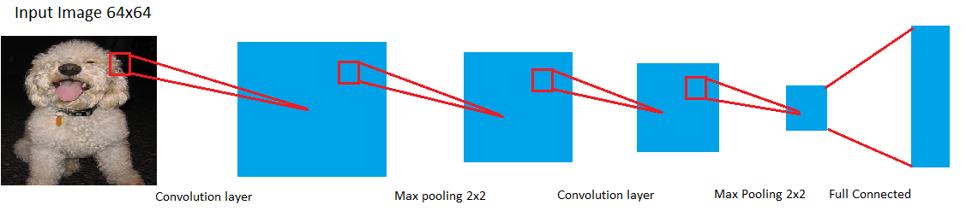
CNN model

Slide 5
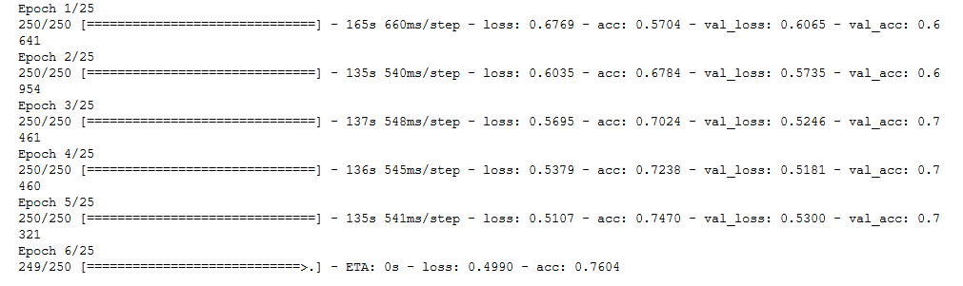
CNN results
There are 25 epochs used for training, after each epoch the loss and accuracy is given along with the validation loss and accuracy.

Slide 6
The RNN program
The RNN project uses a recurrent neural network to train a program to predict google and amazon stocks. A graph based on the programs prediction is made and is compared to the true stock graph. However, since the stock market can be unpredictable, the accuracy of the predictions are sometimes inconsistent. There are 2 versions of the RNN: RNN Notebook.ipynb2, which uses tensorflow to predict google stocks; and RNN_Keras.ipynb, which uses keras to predict amazon stocks.

Slide 7
RNN data sets
The program is trained on 3947 data points from google and amazon stock prices. There are 4 different data files used for the RNN; amzn.txt, daily_amzn.csv, daily_goog.csv, and goog.txt. The .csv files are data generated by an API and the .txt files are derived from the data needed from the .csv files and put into a format that the program can read. Amzn.txt is data from Amazon stocks and goog.txt is data from Google stocks.
To get the most recent datasets for the RNN program, you will need to get an API key.
Head to https://www.alphavantage.co/ and click on "GET YOUR FREE API KEY TODAY"
Enter in your information then click "GET FREE API KEY"
Now in order to use this key to get the most recent datasets, you will need to enter it into the terminal command given below for both the goog dataset and the amzn dataset.
curl -o daily_amzn.csv "https://www.alphavantage.co/query? function=TIME_SERIES_DAILY&symbol=amzn&apikey=<APIKEYHERE>&datatype=csv&outputsize=full"
curl -o daily_goog.csv "https://www.alphavantage.co/query? function=TIME_SERIES_DAILY&symbol=amzn&apikey=<APIKEYHERE>&datatype=csv&outputsize=full"

Slide 8
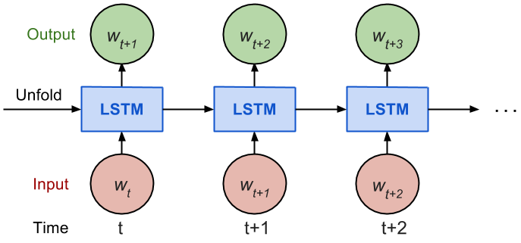
RNN model
https://lilianweng.github.io/lil-log/assets/images/unrolled_RNN.png

Slide 9
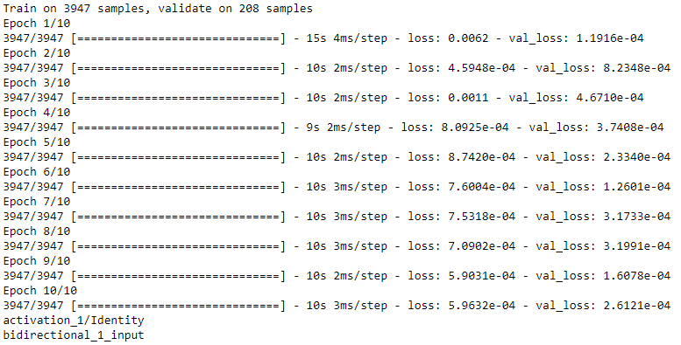
RNN training using keras
10 epochs are used for training, after each epoch the loss and validation loss are given.

Slide 10
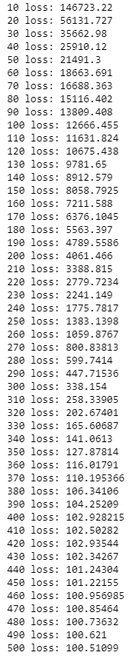
RNN training using tensorflow
The output during the training for the tensorflow program are shown on the right. It shows the loss and the input data.

Slide 11
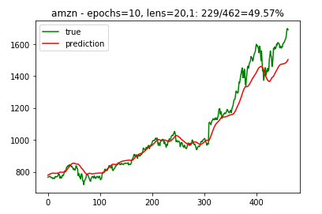
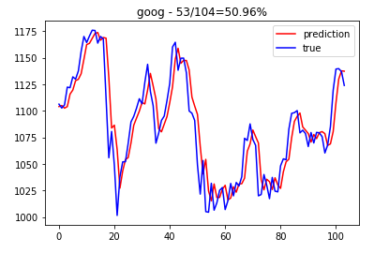
RNN results (part 2)
When the training is done, the program gives a graph that shows the predicted stocks compared to the true stocks along with the accuracy of the prediction. The amazon prediction is on the left (using keras) and the google on the right (using tensorflow). The Percentage number above the graph shows that the prediction was 49.57% accurate for Amazon and 50.96% for Google.

Slide 12
Github and references
Github link: https://github.com/venkateshreddypala/deeplearning-6905
CNN reference: https://www.google.com/url?q=https://medium.com/@curiousily/tensorflow-for-hackers-part-iii-convolutional-neural-networks-c077618e590b&sa=D&source=hangouts&ust=1529354751956000&usg=AFQjCNH-C2xpfthrvPFj2qOi_Sh25PKhOQ
RNN reference: https://youtu.be/ftMq5ps503w
RNN model retrieved from: https://lilianweng.github.io/lil-log/2017/07/08/predict-stock-prices-using-RNN-part-1.html

